Slide 1
Measuring Ultrashort Laser Pulses IV: More Techniques
Sonogram: spectral gating fol-
lowed by cross-correlation
Using self-phase modulation to almost measure pulses
Measuring ultraweak ultrashort pulses: Spectral Interferometry
Measuring ultrafast variation of polarization
Spatio-temporal measurement of ultrafast light
Spectral interferometry with out a reference pulse (SPIDER)
1/τ
τ
E
unk
E
ref
frequency
Spectrometer
Camera
Rick Trebino, Georgia Tech, rick.trebino@physics.gatech.edu

Slide 2
The Sonogram and its relation to the spectrogram
They’re experimentally very different, but mathematically equivalent.
Spectrogram
frequency
time
Spectrogram: “What frequencies occur at a given time?”
Sonogram
time
frequency
Sonogram: “At what times does a given frequency occur?”

Slide 3
Measuring Sonograms of Pulses Using a Shorter Event
To make a sonogram, we must frequency-filter and then measure the intensity of the filtered pulse vs. the central frequency of the filter.
The shorter event
Fast Photodetector
or
Cross Correlator
Tunable
Optical
Filter
Optical signal
Oscilloscope
E(ω)
H(ω−ω_{c})
ω_{c}= filter center
frequency
Computer
Sn_{E}(ω_{c},τ)
Requirements: a tunable filter with sufficient frequency resolution and a
fast photodiode or cross-correlator with sufficient temporal resolution

Slide 4
Measuring the sonogram without a shorter event
Treacy (1971), and Chilla & Martinez (1991)
This method uses the pulse itself to cross-correlate the filtered (lengthened) pulse.

Slide 5
Sonogram of a Linearly Chirped Pulse

Slide 6
Sonogram of a 10 Gbps Differential-Phase-Shift-Keying Signal
Differential phase shift keying (DPSK) involves amplitude modulation
from -1 to +1 and back (phase shifts from 0 to π).
So the intensity remains constant.
The phase shifts appear clearly as dark (blue) regions of the sonogram.
Theory:
Exp’t:
2
0
1
0
Frequency (GHz)
0
-
1
0
-
2
0
-
0
.
2
0
0
.
2
0
.
4
0
.
6
0
.
8
1
-
0
.
2
0
0
.
2
0
.
4
0
.
6
0
.
8
1
Time (ns)
Time (ns)
Kuznetsov and Caplan, Lincoln Lab CLEO 2000

Slide 7
Advantages and Disadvantages of the Sonogram
Advantages
Approximate non-iterative retrieval is possible.
The FROG algorithm can be modified to retrieve pulses from the sonogram rigorously.
No ambiguity in the direction of time.
Disadvantages
Non-iterative retrieval is so rough that it shouldn’t be used (mean vs. median vs. mode…).
More difficult experimentally than the spectrogram.
Less sensitive, since energy is wasted at the filter before the crystal.
Single-shot operation is difficult.
Error-checking and error-correction are not straightforward.

Slide 8
Pulse Measurement Using Self-Phase Modulation
Piece of glass

Slide 9
Sensitivity of FROG

Slide 10
Measuring Ultraweak Ultrashort Light Pulses
Because ultraweak ultrashort pulses are almost always created by
much stronger pulses, a stronger reference pulse is always available.
Use Spectral Interferometry
1/τ
τ
E
unk
E
ref
frequency
Spectrometer
Camera
This involves no nonlinearity! ... and only one delay!
Froehly, et al., J. Opt. (Paris) 4, 183 (1973)
Lepetit, et al., JOSA B, 12, 2467 (1995)
C. Dorrer, JOSA B, 16, 1160 (1999)
Fittinghoff, et al., Opt. Lett., 21, 884 (1996).
FROG + SI = TADPOLE
(Temporal Analysis by Dispersing a
Pair Of Light E-fields)

Slide 11
SI allows us to obtain the difference between the two spectral phases.
Central peak
contains only
spectrum
information
This is not “the”
time domain. We’re
Fourier-transforming
an intensity. So we’ll
put “time” in quotations.
Spectral Interfer-
ometry Spectrum
FFT
ω₀
Frequency
0
“time”
Filter
out these
two peaks
Spectral Phase Difference
(after taking phase
of result)
Filter
&
Shift
IFFT
ω₀
Frequency
0
“time”
Subtracting off the spectral phase of the reference pulse yields the
unknown-pulse spectral phase.
Interferogram Analysis, D. W. Robinson and G. T. Reid, Eds.,
Institute of Physics Publishing, Bristol (1993) pp. 141-193

Slide 12
Sensitivity of Spectral Interferometry (TADPOLE)
1 microjoule
= 10
–
6
J
1 nanojoule
= 10
–
9
J
A pulse train containing only 42 zepto-
joules (42 x 10⁻²¹ J) per pulse has been
measured.
That’s one photon every five pulses!
Fittinghoff, et al., Opt. Lett. 21, 884 (1996).
1 picojoule
=
10
–
12
J
1 femtojoule = 10
–
15
J
1 attojoule = 10
–
18
J
TADPOLE
can measure pulses
with as little energy as:
1 zeptojoule =
10
–
21
J

Slide 13
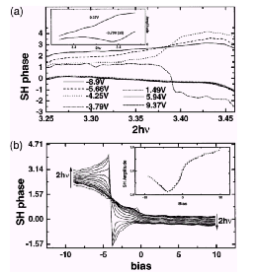
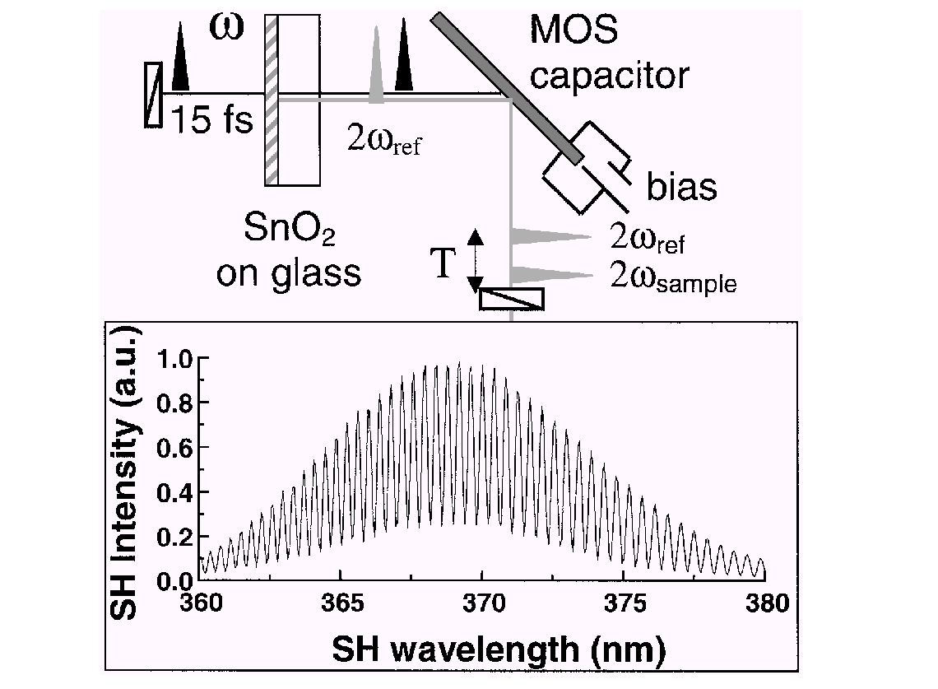
Applications of Spectral Interferometry
Frequency domain interferometric second-harmonic (FDISH) spectroscopy
The phase of the second harmonic produced on the MOS capacitor is measured relative to the reference second harmonic pulse produced by the SnO₂ on glass.
A π phase shift is seen at –4 V.
P. T. Wilson, et al., Optics Letters, Vol. 24, No. 7 (1999)

Slide 14
Unpolarized light doesn’t exist…
POLLIWOG (POLarization-Labeled Interference vs. Wavelength for Only a Glint*)
* Glint = “a very weak, very short pulse of light”

Slide 15
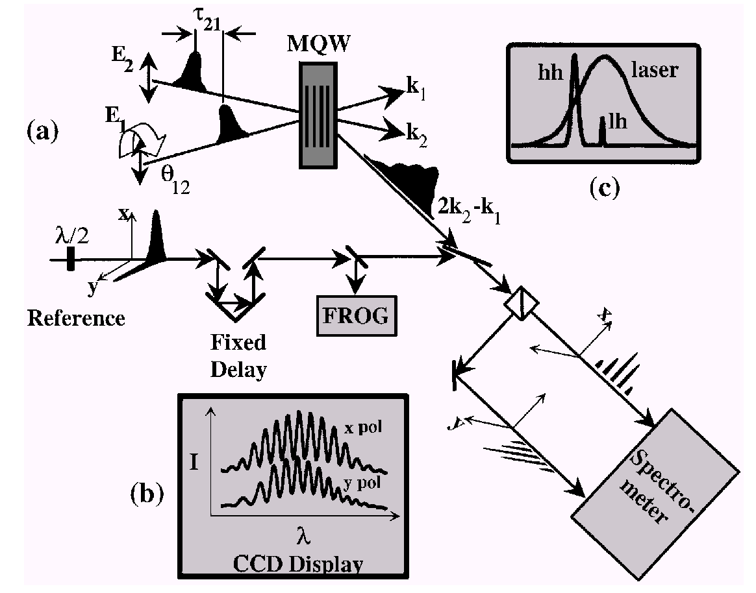
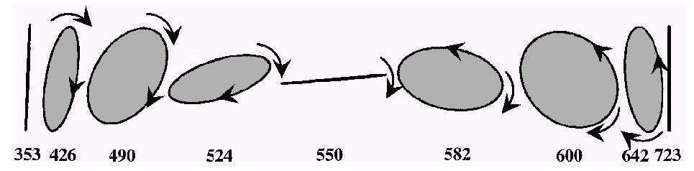
Application of POLLIWOG
Measurement of the variation of the polarization state of the emission from a GaAs-AlGaAs multiple quantum well when heavy-hole and light-hole excitons are excited elucidates the physics of these devices.
Excitation-laser spectrum and hh and lh exciton spectra
Evolution of the polarization of the emission:
time (fs)
A. L. Smirl, et al., Optics Letters, Vol. 23, No. 14 (1998)

Slide 16
Measuring the Intensity and Phase vs. Time and Space
Spectral interferometry only requires measuring one spectrum.
Using the other dimension of the CCD camera for position,
we can measure the pulse along one spatial dimension, also.
Δτ
Microscope Slide
Fringe spacing is larger due to delay produced by slide (ref pulse was later).
Without Slide
With Slide

Slide 17
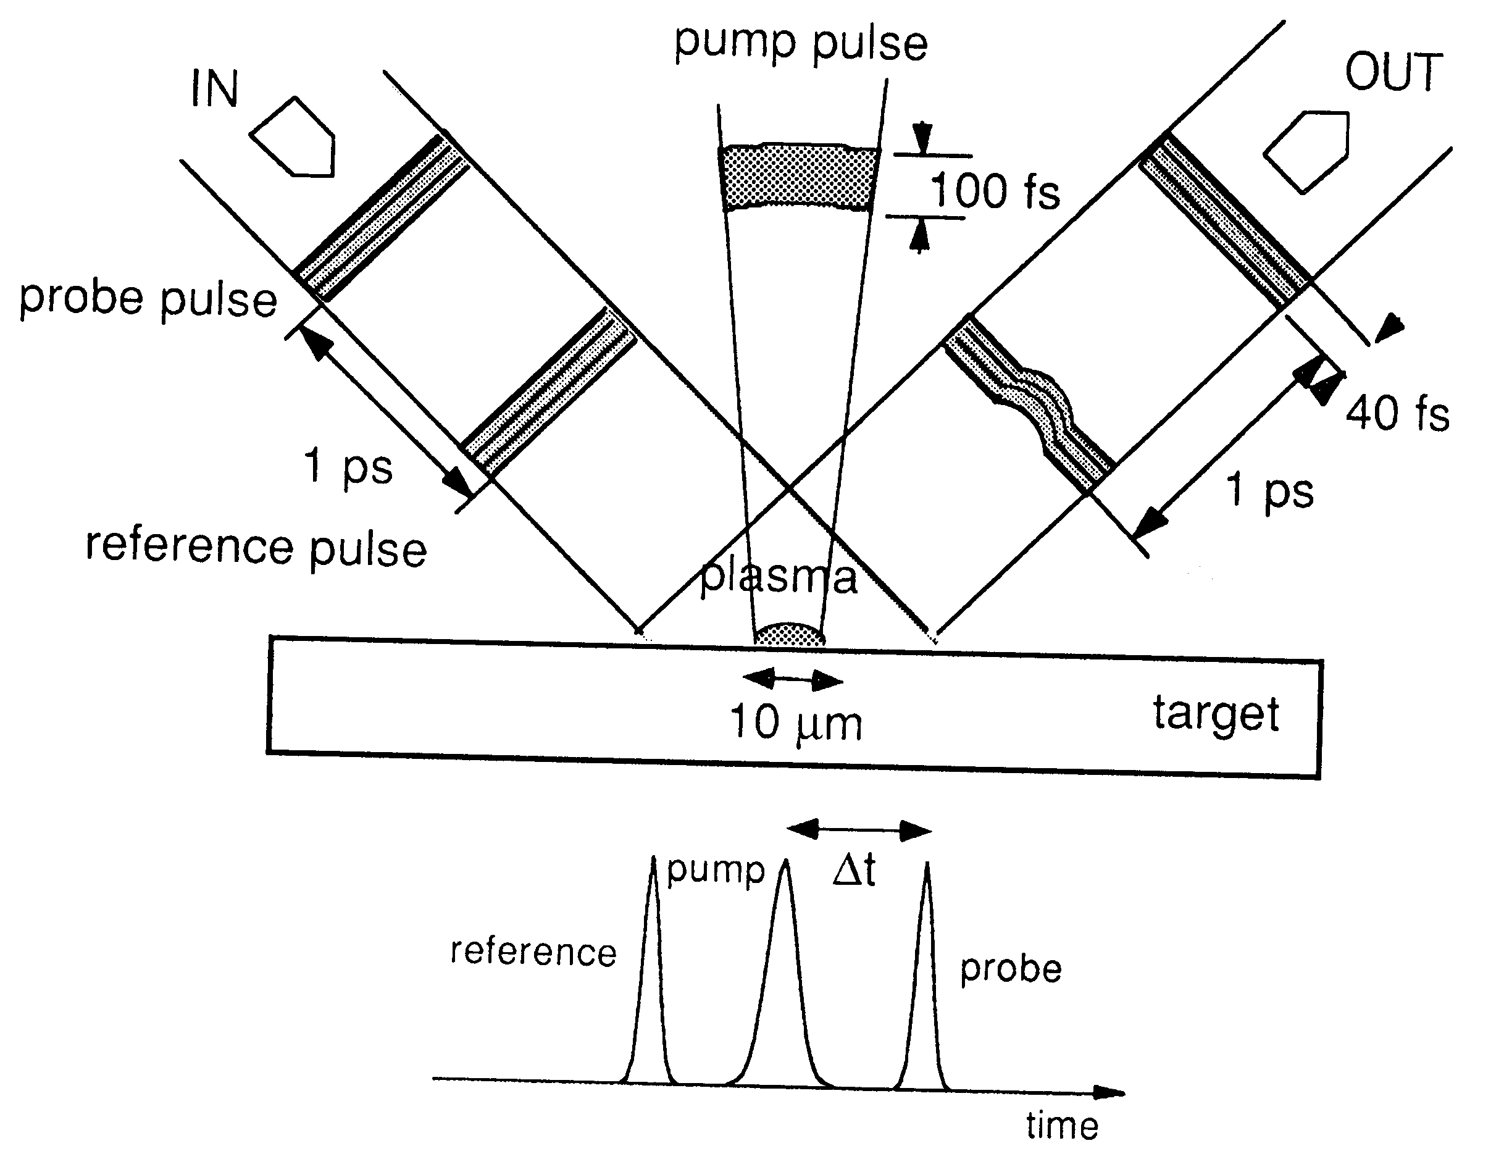
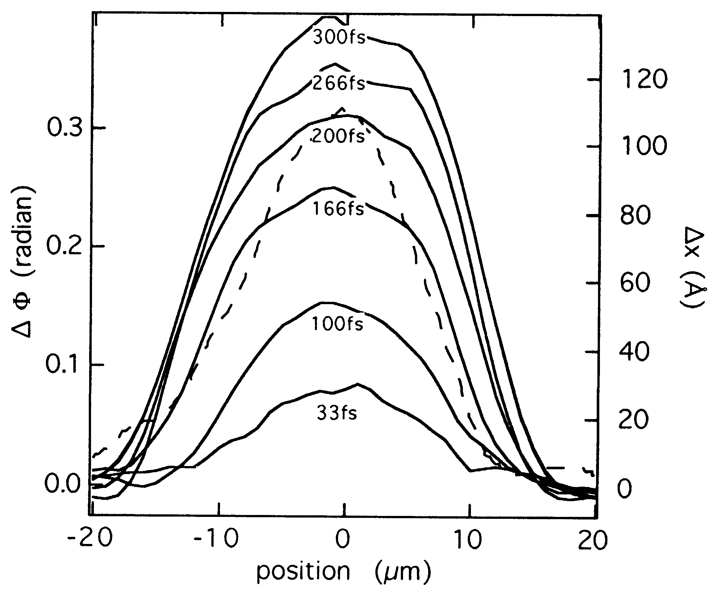
Application of Spatio-Temporal Pulse Measurement: Plasma Diagnostics
Use three pulses (in order):
1. a reference pulse,
2. a strong pump pulse (from a different direction) to create a plasma,
3. a probe pulse, initially identical to the reference pulse.
Set up:
Results:
To spectro-
meter
Geindre, et al., Opt. Lett., 19, 1997 (1994).

Slide 18
Spatio-temporal intensity and phase measurements will be useful for studying:
Spatial distortions in stretchers/compressors.
Pulse front distortions due to lenses.
Structure of inhomogeneous materials.
Pulse propagation in plasmas and other materials
Anything with a beam that changes in space as well as time!

Slide 19
Spectral Interferometry: Experimental Issues
The interferometer must be stable, the beams must be very well aligned, and the beams must be mode-matched.
Mode-matching is important or the fringes wash out.
The time delay must be stable or the fringes wash out.
Unknown
CW background in the laser can add to the signal and mask it.
Spectrometer
Beams must be perfectly collinear or the fringes wash out.
Phase stability is crucial or the fringes wash out.

Slide 20
Spectral Interferometry: Pros and Cons
Advantages
  It’s simple—requires only a beam-splitter and a spectrometer
  It’s linear and hence extremely sensitive. Only a few
  thousand photons are required.
Disadvantages
  It measures only the spectral-phase difference.
  A separately characterized reference pulse is required to
    measure the phase of a pulse.
  The reference pulse must be the same color as the
    unknown pulse.
  It requires careful alignment and good stability—it’s an
  interferometer.

Slide 21
Using spectral interferometry to measure a pulse without a reference pulse: SPIDER
If we perform spectral interferometry between a pulse and itself, the spectral phase cancels out. (Perfect sinusoidal fringes always occur.)
It is, however, possible to use a modified version of SI to measure a pulse, provided that a nonlinear effect is involved.
The trick is to frequency shift one replica of the pulse compared to the other.
This is done by performing sum-frequency generation between a strongly chirped pulse and a pair of time-separated replicas of the pulse.
SI performed on these two up-shifted pulses yields essentially the derivative of the spectral phase.
This technique is called: Spectral Phase Interferometry for Direct Electric-Field Reconstruction (SPIDER).
Iaconis and Walmsley, JQE 35, 501 (1999).

Slide 22
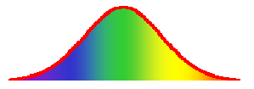





How SPIDER works
Input pulses
Output pulses
Chirped pulse
Two replicas of the pulse are produced, each frequency shifted by a different amount.
t
This pulse sums with the blue part of the chirped pulse.
This pulse sums with the green part of the chirped pulse.
τ
t
t
SFG
Performing SI on these two pulses yields the difference in spectral phase at nearby frequencies (separated by δω). This yields the spectral phase.
Iaconis and Walmsley, JQE 35, 501 (1999).

Slide 23
SPIDER apparatus
Focusing
Lens
Delay
Line
Lens
M
Spectrometer
SHG
crystal
Filter
BS
Delay
Line
Aperture
BS
Pulse Stretcher
Michelson
Interferometer
Grating
Input
BS
BS
Grating
SPIDER yields the spectral phase of a pulse, provided that the delay between the pulses is larger than the pulse length and the resulting frequency fringes can be resolved by the spectrometer.

Slide 24
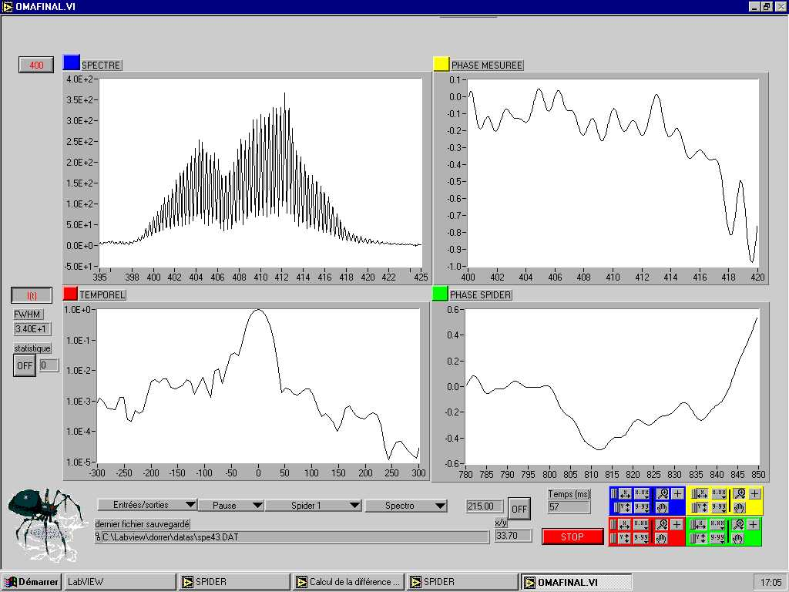
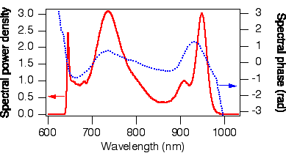
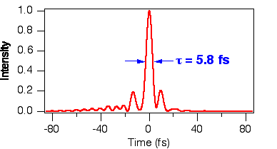
SPIDER: extraction of the spectral phase
Extraction of the spectral phase
Measurement of the interferogram
Extraction of their spectral phase difference using spectral interferometry
Integration of the phase
Experimental measurement:
L. Gallmann et al, Opt. Lett., 24, 1314 (1999)

Slide 25
Can we simplify SPIDER?
SPIDER has 12 sensitive alignment degrees of freedom.
Pulse to be measured
Michelson
Interferometer
5 alignment parameters
(θ, φ for each BS and delay)
Variable delay
SHG
crystal
Camera
Spec-
trom-
eter
Variable delay
Pulse Stretcher
Grating
4 alignment parameters θ
(θ for each grating and
θ, φ for the mirror)
3 alignment θ parameters θ
(θ, φ for a mirror and θ delay) θ
What remains is a FROG!!!
Grating

Slide 26
Advantages and Disadvantages of SPIDER
Advantages
Pulse retrieval is direct (i.e., non-iterative) and hence fast.
Minimal data are required: only one spectrum yields the spectral phase.
It naturally operates single-shot.
Disadvantages
Its apparatus is very complicated. It has 13 sensitive alignment parameters
(5 for the Michelson; 2 in pulse stretching; 1 for pulse timing;
2 for spatial overlap in the SHG crystal; and 3 for the spectrometer).
Like SI, it requires very high mechanical stability, or the fringes wash out.
Poor beam quality can also wash out the fringes, preventing the measurement.
It has no independent checks or feedback, and no marginals are available.
It cannot measure long or complex pulses: TBP < ~ 3. (Spectral resolution is
~10 times worse than that of the spectrometer due to the need for fringes.)
It has poor sensitivity due to the need to split and stretch the pulse
before the nonlinear medium.
The pulse delay must be chosen for the particular pulse. And pulse structure
can confuse it, yielding ambiguities.

Slide 27
Generic Ultrafast Measurement

Slide 28
New, Improved Generic Ultrafast Measurement

